Slide 1
PCAP Threat Hunting Project: Real-World Network Intrusion Analysis & Mitigation
A Self-Learning Cybersecurity Research Project using
Open-Source PCAP Data
Presented By
Amna Amjid
Cybersecurity Professional | Information Security Engineer | Cybersecurity Researcher | SOC Analyst

Slide 2
Project Overview
Self-initiated project to explore real-world cyberattacks
PCAP file downloaded from open-source repositories for analysis [1]
Goal: Learn attacker TTPs, practice forensics, and implement mitigation
[1] (https://www.netresec.com/?page=PcapFiles)

Slide 3


Tools & Technologies
Tool | Purpose
Wireshark | Network Forensics
Linux CLI | Terminal Analysis
Bash | Mitigation Script
MITRE ATT&CK Framework | Attack Mapping

Slide 4
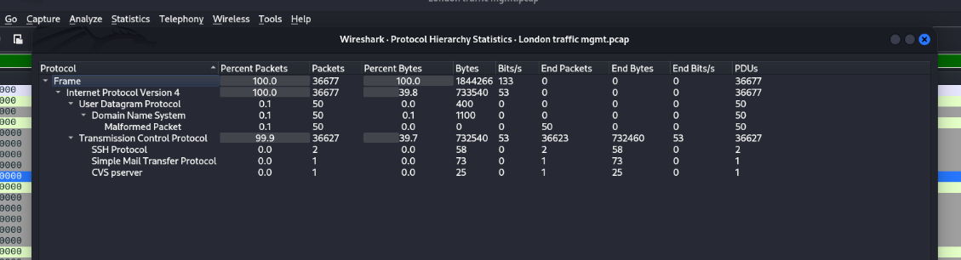
PCAP File Overview
Number of packets: 36,000+
Protocols observed: TCP, DNS, HTTP, SMTP, SSH

Slide 5
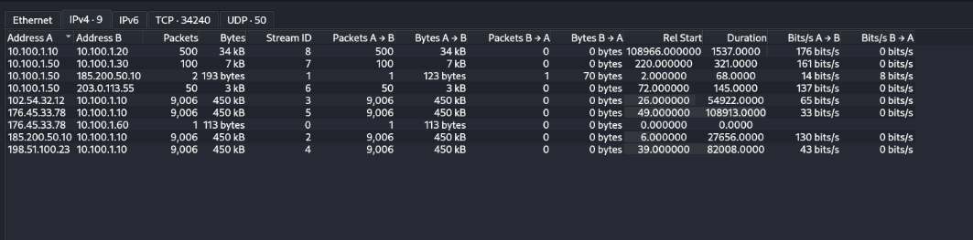
PCAP File Overview
Key anomalies detected: DNS tunneling, malformed packets, SYN floods
Brief note: Dataset mimics a real-world infrastructure attack

Slide 6
Attack Timeline
Phishing Email (SMTP)
02
Recon (SYN Scan)
04
DNS Tunneling (C2)
06
DDoS (SYN Flood)
08
Credential Harvesting (HTTP POST)
Remote Code Execution (SSH)
Internal Pivoting (API Hijack)
SQL Exfiltration
01
03
05
07

Slide 7
MITRE ATT&CK Mapping
Phase | Indicators & Actions
Initial Access | Phishing email via SMTP; credential theft via HTTP
Reconnaissance | Multi-source SYN scans targeting common ports
Exploitation | SSH RCE exploit using encrypted payloads
C2 Establishment | DNS tunneling using malformed DNS to remote server
Lateral Movement | API Hijack via internal host communication over port 8080
DDoS | 36,000+ SYN flood packets targeting web services (port 80)
Impact Stage | S QL query to extract traffic light configuration

Slide 8
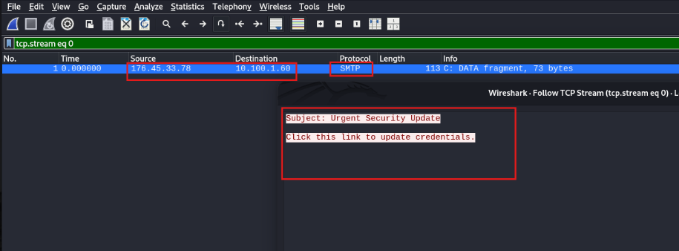
Phase:01 Initial Access via Phishing Email

Slide 9
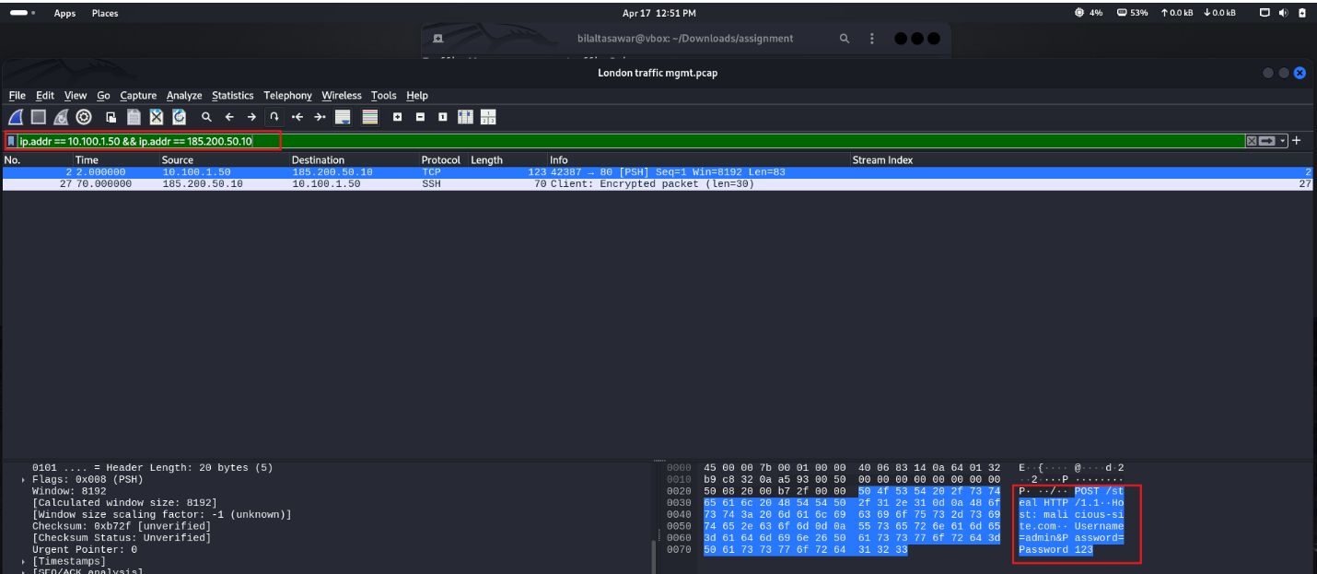
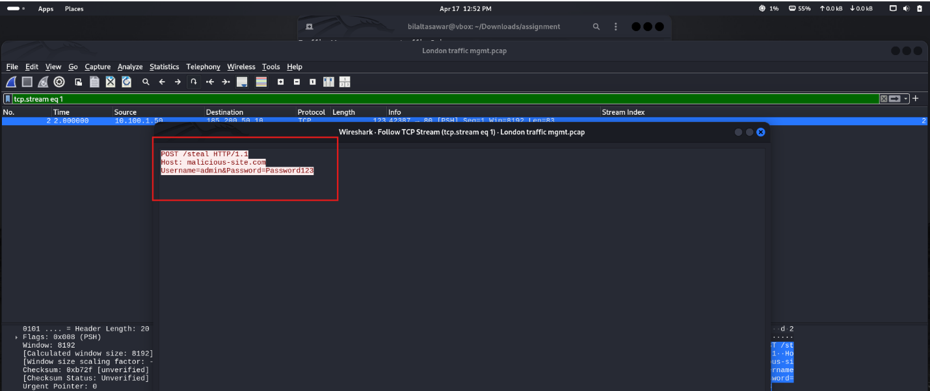
Phase:01 Credential theft via HTTP

Slide 10
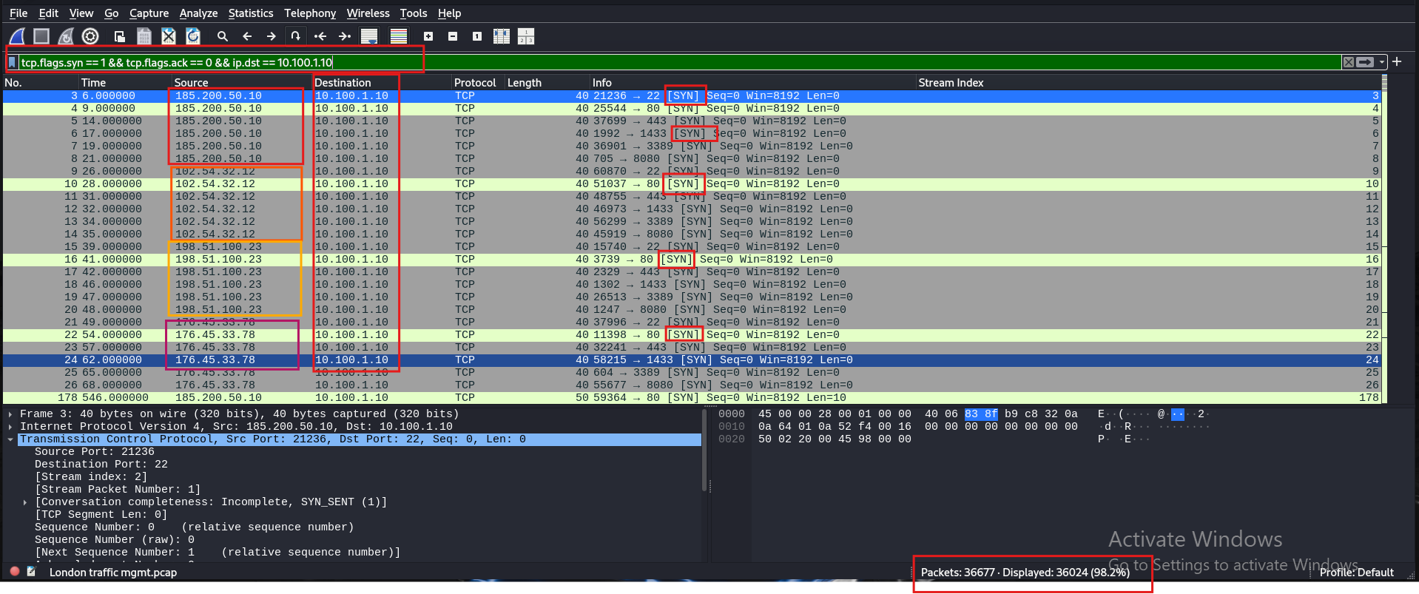
Phase:02 Reconnaissance

Slide 11
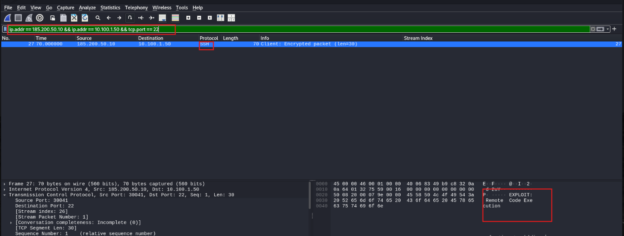
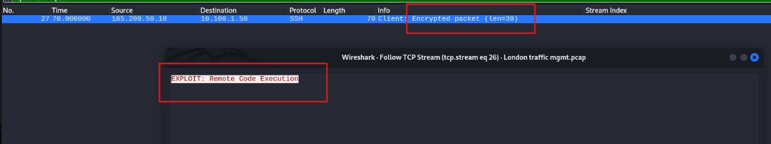
Phase:03 Exploitation via SSH RCE exploit using encrypted protocol

Slide 12
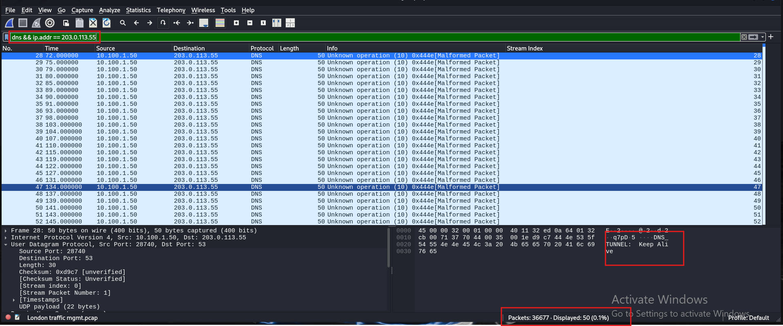
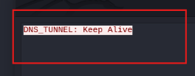
Phase:04 C2 Establishment via DNS tunneling using malformed DNS to remote server

Slide 13
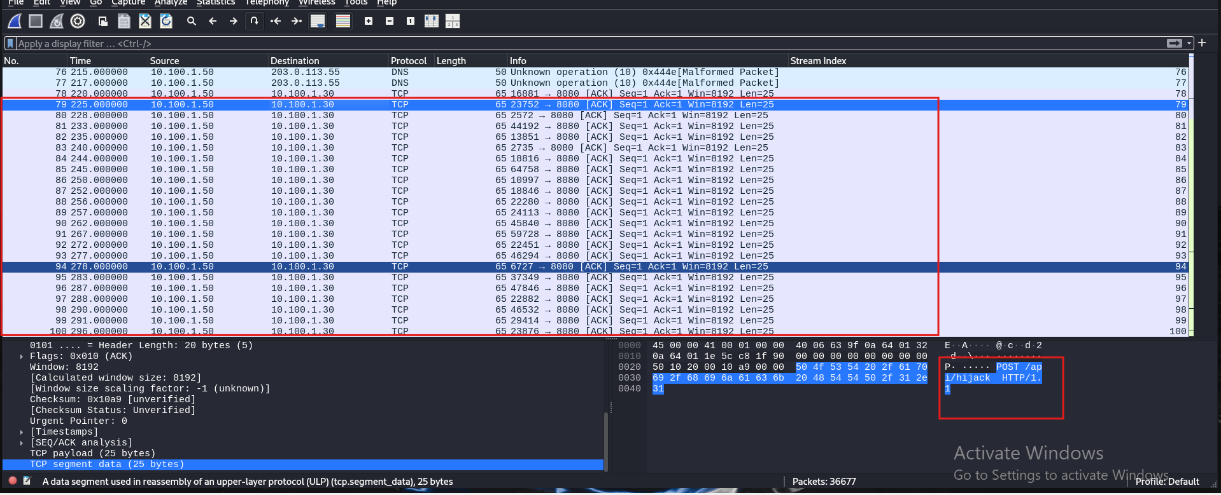
Phase:05 Lateral Movement API Hijack via internal host communication over port 8080

Slide 14
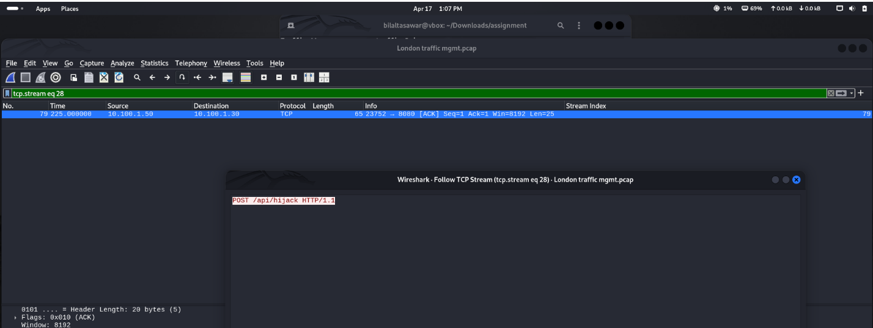
Phase:05 Lateral Movement API Hijack via internal host communication over port 8080

Slide 15
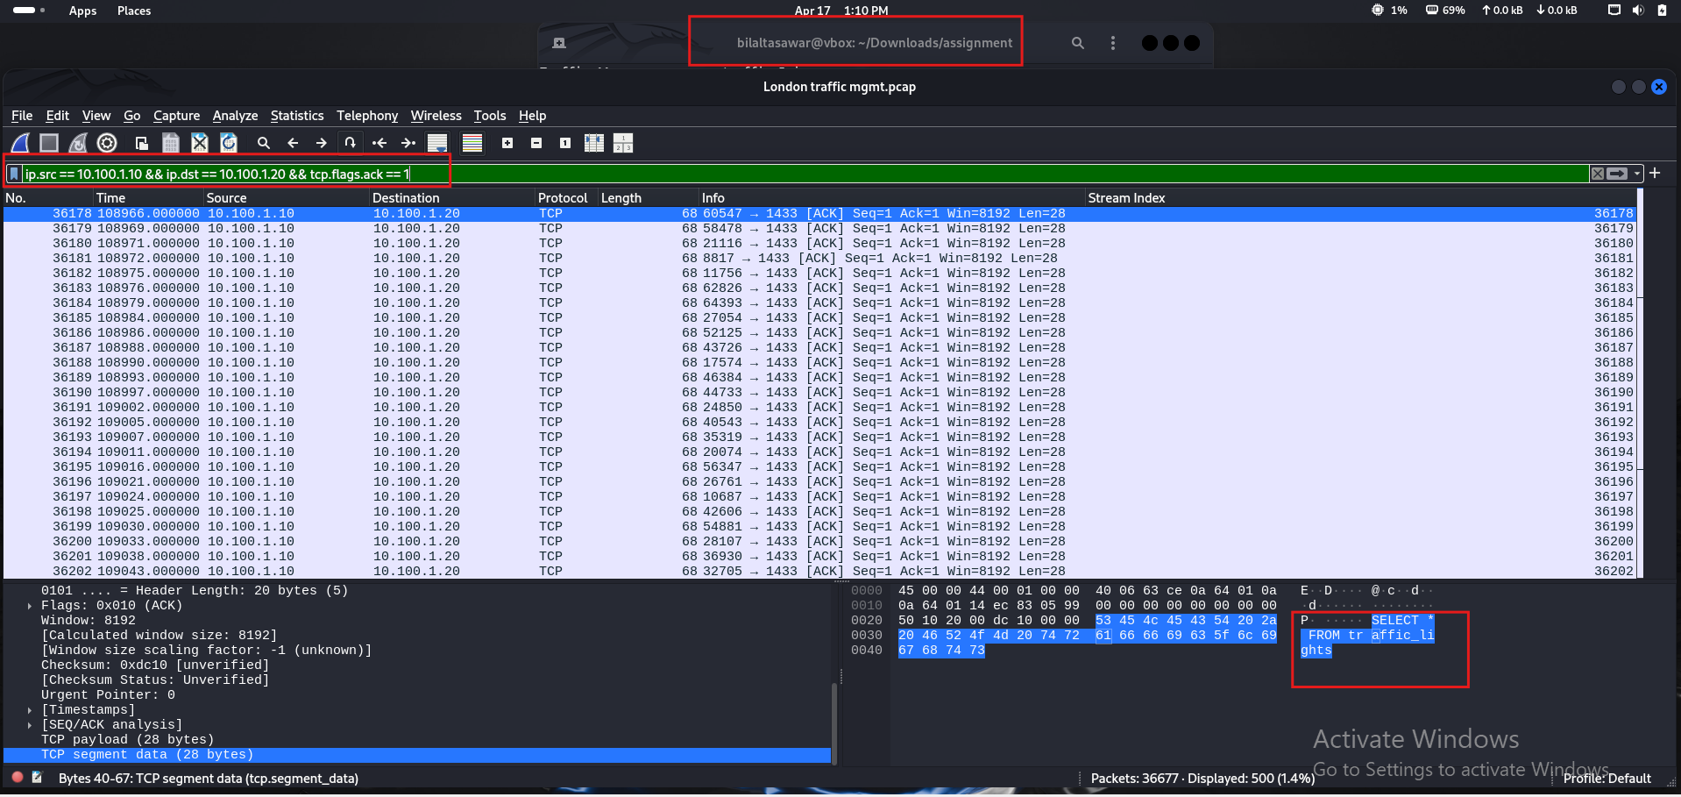
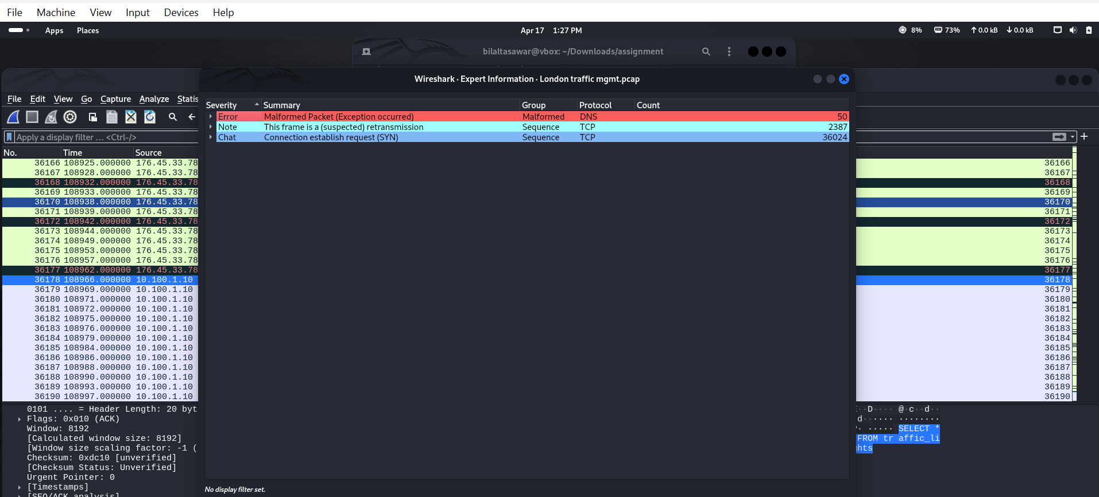
Phase:05 Lateral Movement API Hijack via internal host communication over port 8080

Slide 16
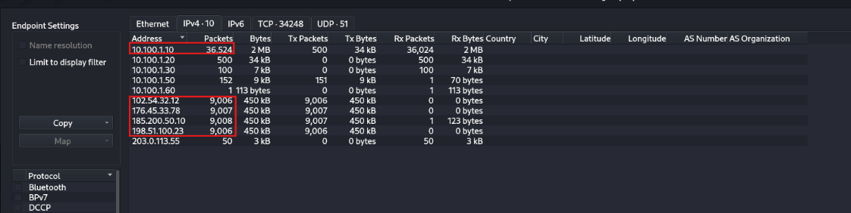
Phase:06 DDoS 36,000+ SYN flood packets targeting web services (port 80)

Slide 17
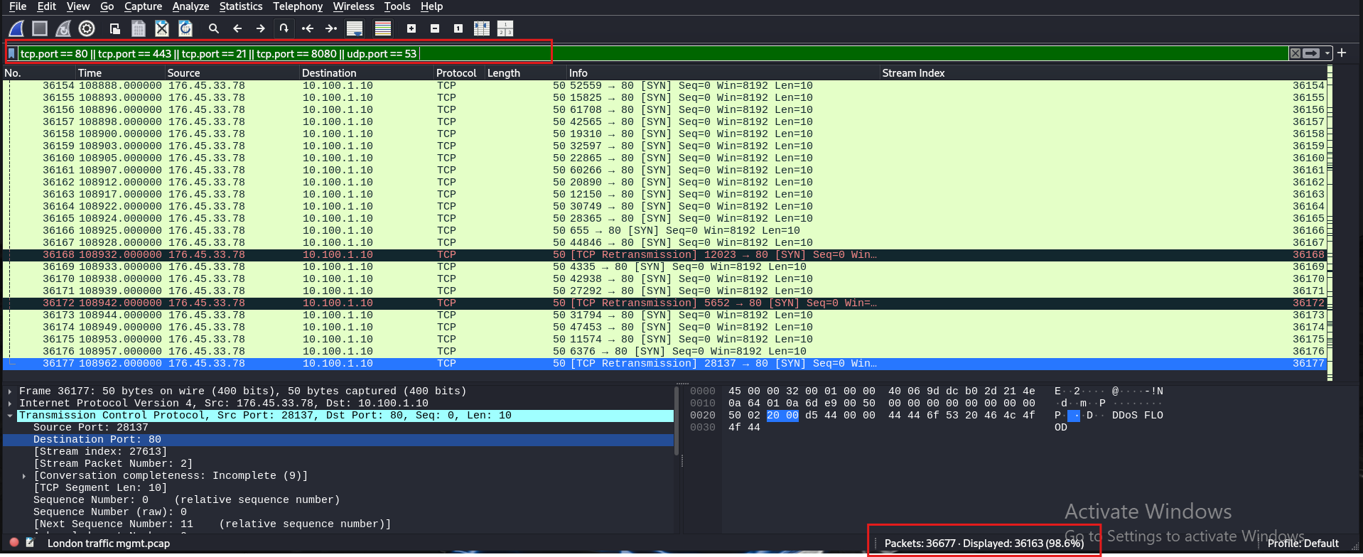
Phase:06 DDoS 36,000+ SYN flood packets targeting web services (port 80)

Slide 18
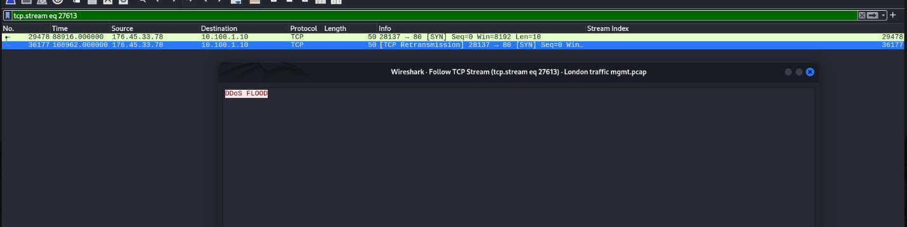
Phase:06 DDoS 36,000+ SYN flood packets targeting web services (port 80)

Slide 19
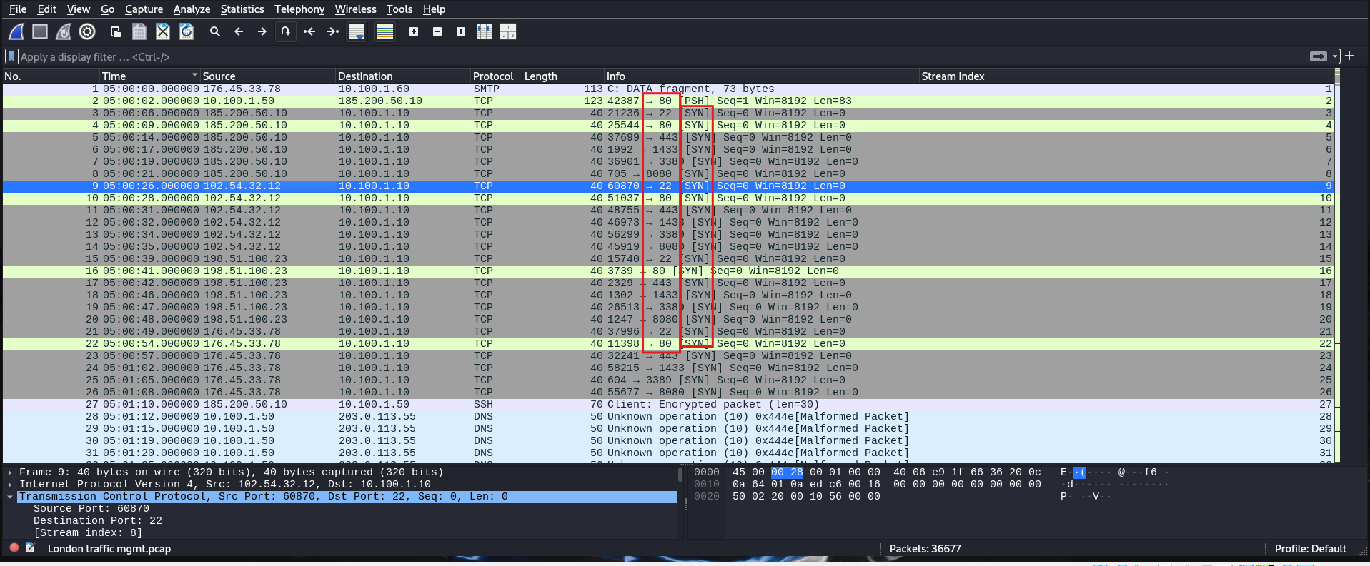
Phase:06 DDoS 36,000+ SYN flood packets targeting web services (port 80)

Slide 20
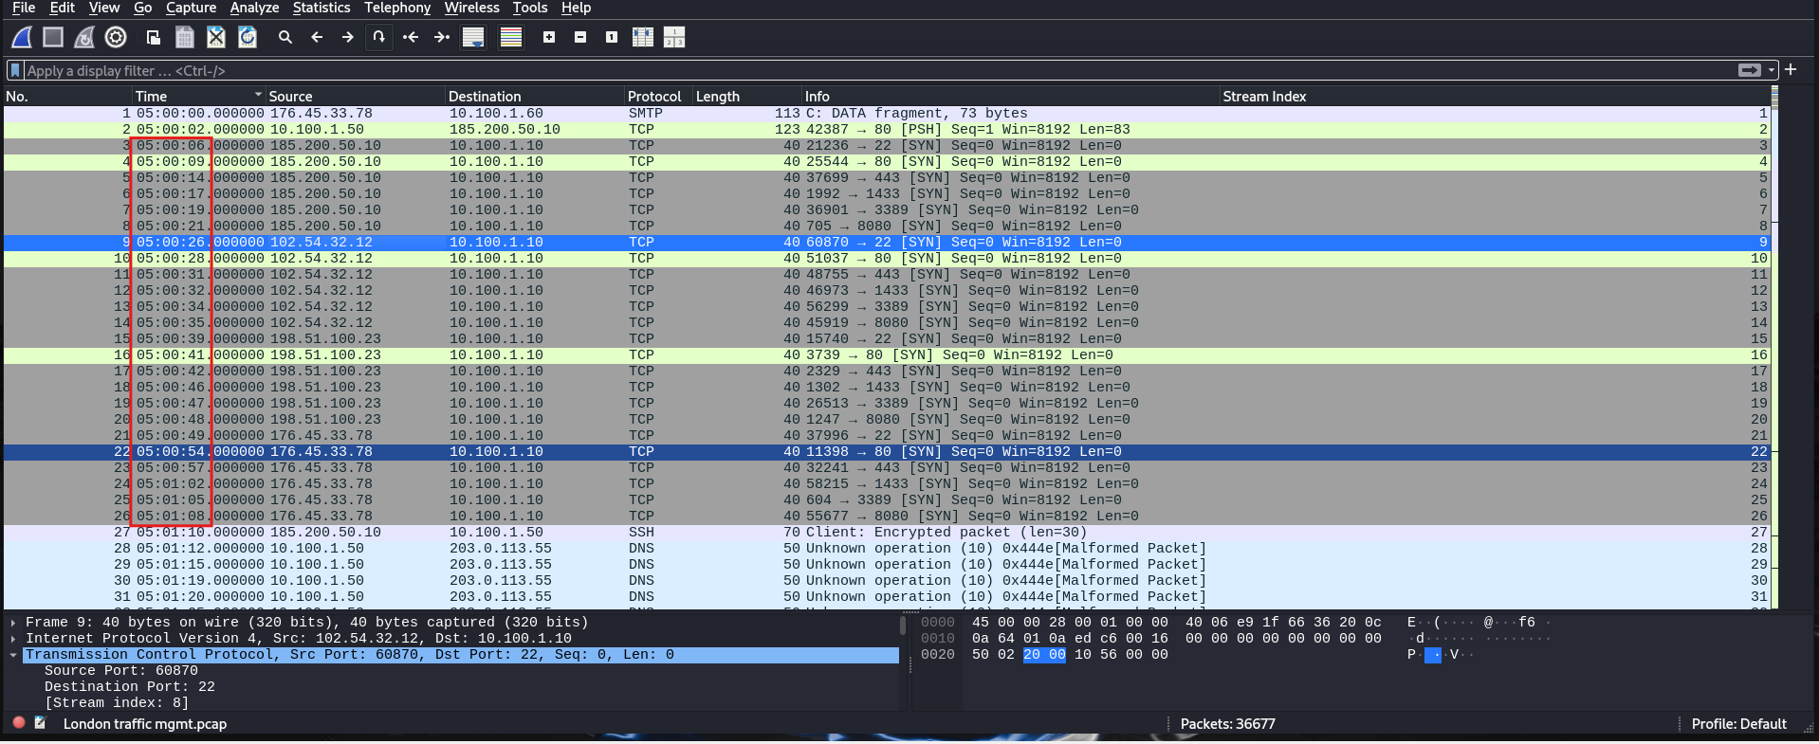
Phase:06 DDoS 36,000+ SYN flood packets targeting web services (port 80)

Slide 21
Phase:06 DDoS 36,000+ SYN flood packets targeting web services (port 80)

Slide 22
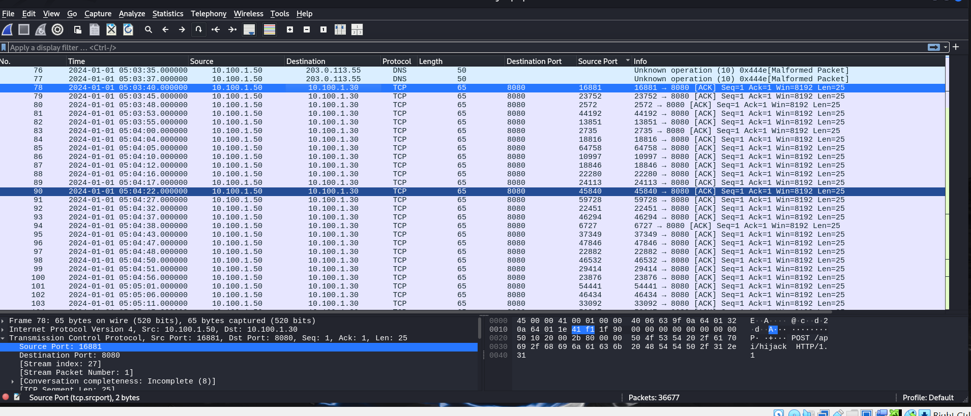
Phase:06 DDoS 36,000+ SYN flood packets targeting web services (port 80)

Slide 23
Phase:06 DDoS 36,000+ SYN flood packets targeting web services (port 80)

Slide 24
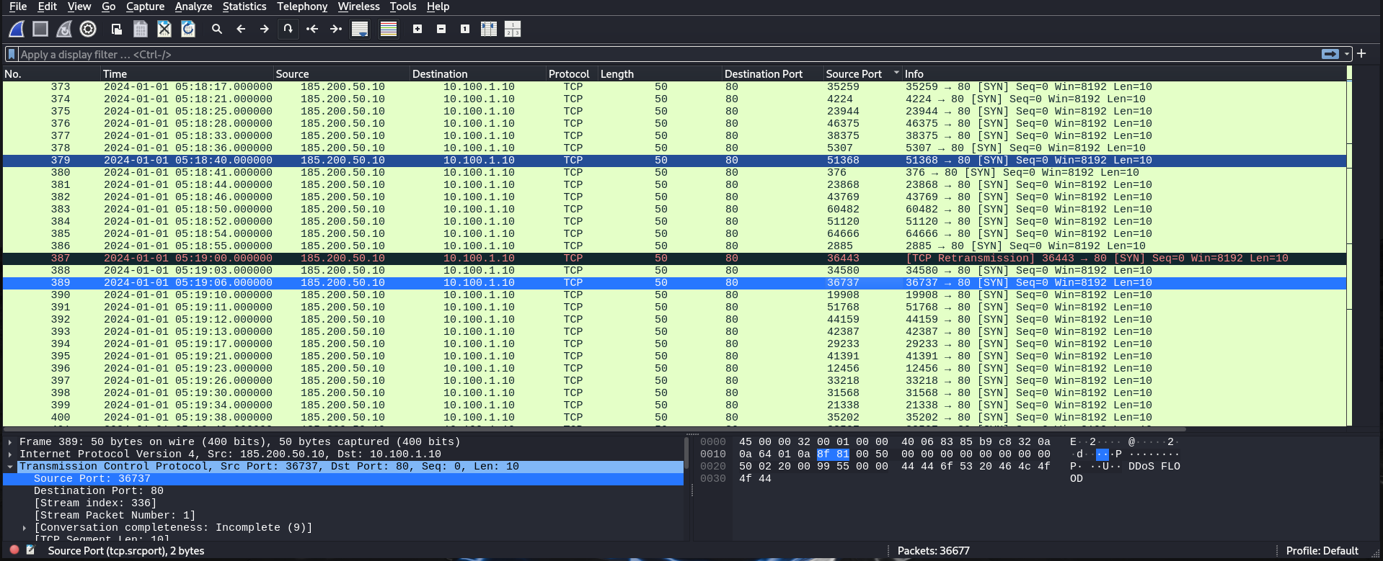
Phase:06 DDoS 36,000+ SYN flood packets targeting web services (port 80)

Slide 25
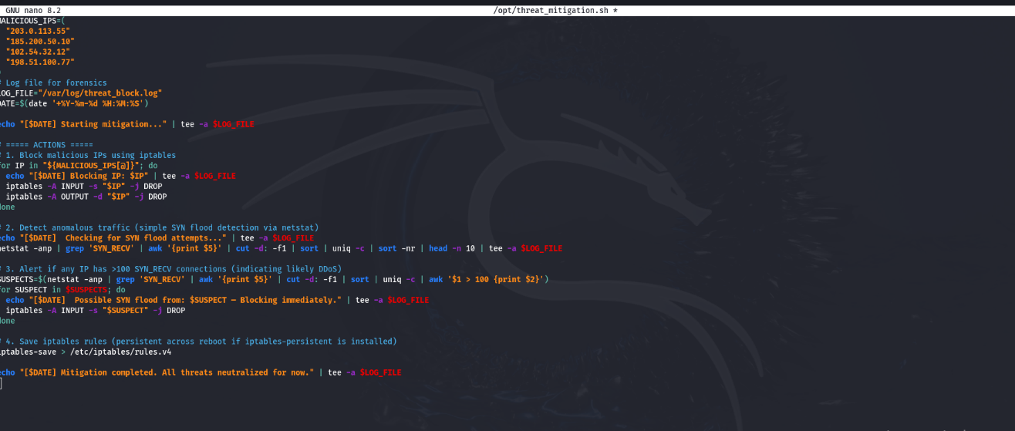
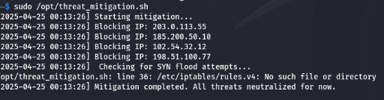
Bash-Based Mitigation Script

